Slide 1
Netflix Data Cleaning, Analysis & Visualization
Subtitle: A Data Project using Python
Swaraj Verma | 10/05/2025 | Tools Used (Python)

Slide 2
Objective: Clean and analyze Netflix dataset (2008–2021) to uncover content trends and enhance data storytelling skills.

Slide 3
Top 10 country wise pie chart

Slide 4
Tools & Technologies
Data Handling & Cleaning:
Python (Jupyter Notebook environment)
Pandas for data manipulation and cleaning
NumPy for numerical operations
Exploratory Data Analysis (EDA):
Seaborn & Matplotlib for data visualization
Value counts, groupings, and trend analysis
Machine Learning (Planned/Future Work)
Scikit-learn for model building tasks.

Slide 5
Pie chart for distribution

Slide 6
Netflix Data: Cleaning, Analysis, and Visualization (Beginner ML Project) This project involves loading, cleaning, analyzing, and visualizing data from a Netflix dataset. We'll use Python libraries like Pandas, Matplotlib, and Seaborn to work through the project. The goal is to explore the dataset, derive insights, and prepare for potential machine learning tasks.
Why Handle Missing Data?
>Missing values can introduce bias and reduce model accuracy.
>Important to assess whether missing data is random or systematic.
>Strategy Used
>Created a custom missing_pct() function to evaluate missing data per column.
>Dropped columns with a high percentage of missing values.
>Applied mean/median imputation based on logical groupings (e.g., average height by gender).
> Duplicate Handling:
>Removed duplicate records to maintain data integrity.

Slide 7
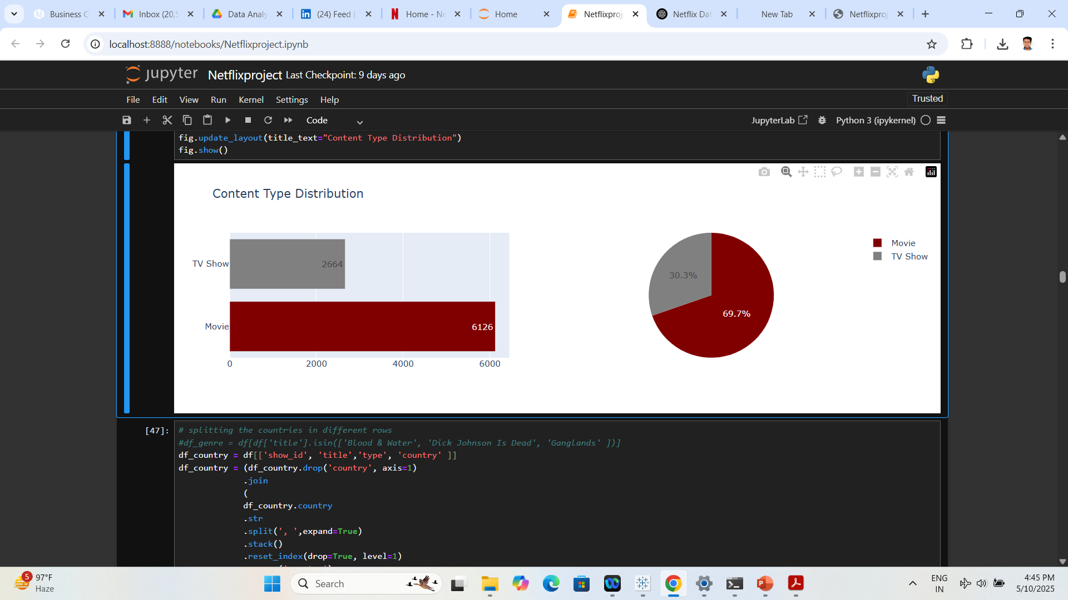
Key Visualizations 🧮 Visualizations Created Using Python (Pandas, Seaborn, Matplotlib):

Slide 8
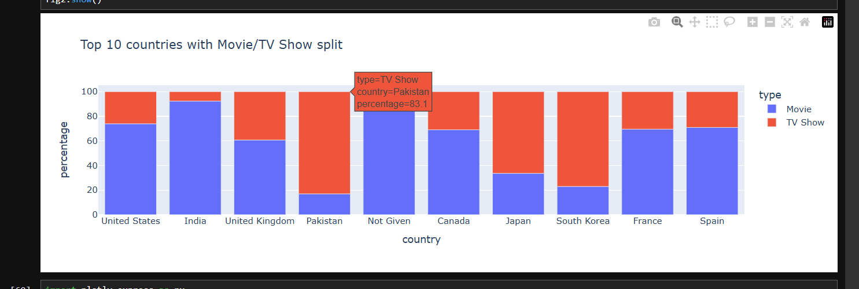
Top 10 countries: movie/TV

Slide 9
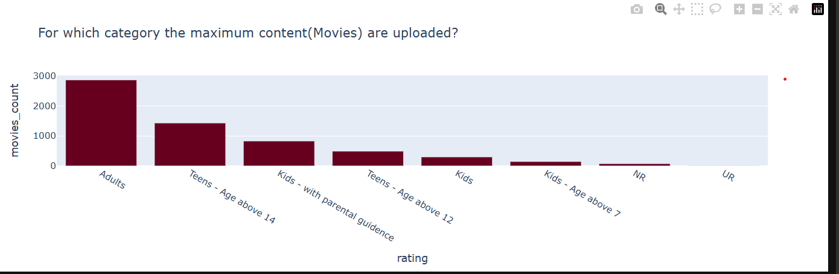
Maximum content

Slide 10
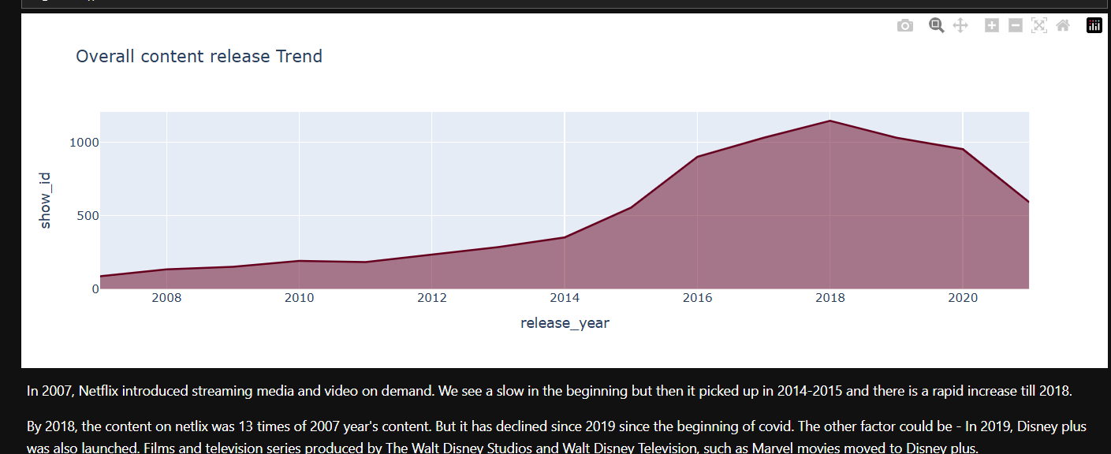
Overall content release trend

Slide 11
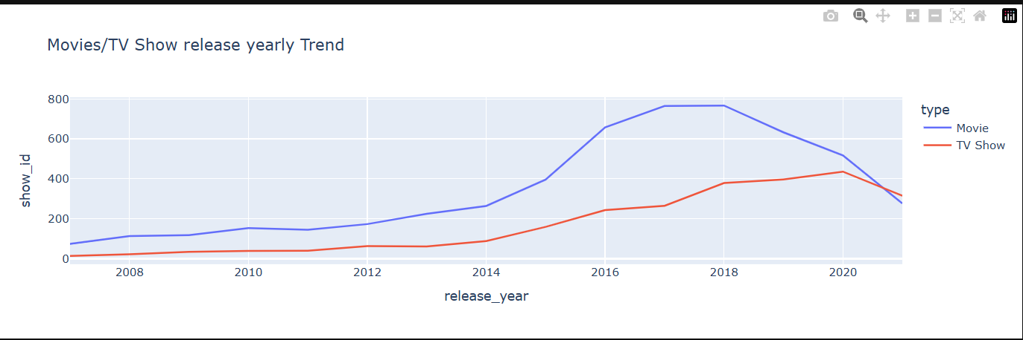
Movies/tv release trend

Slide 12
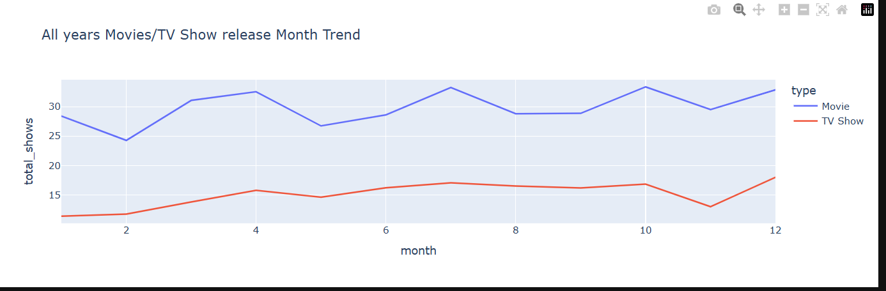
All years movie/tv show month

Slide 13
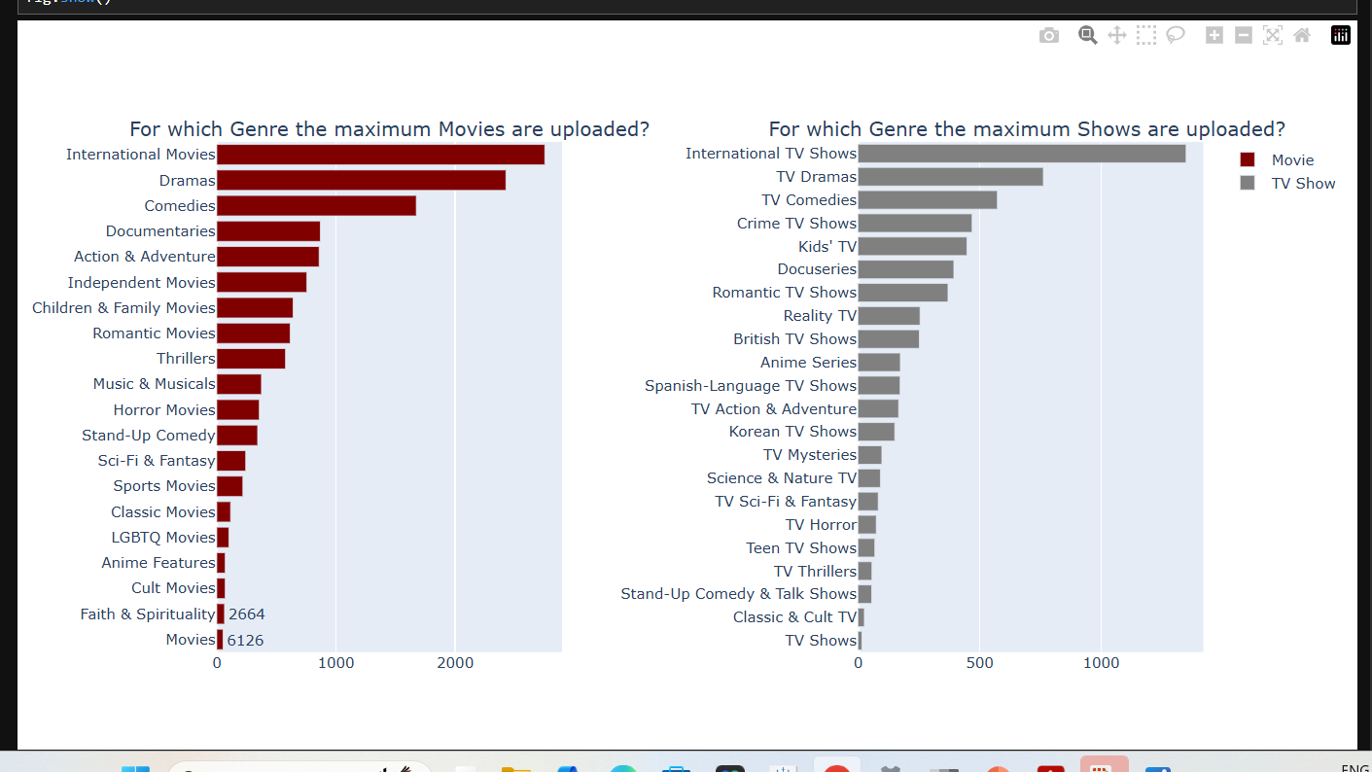
Genre max movies

Slide 14
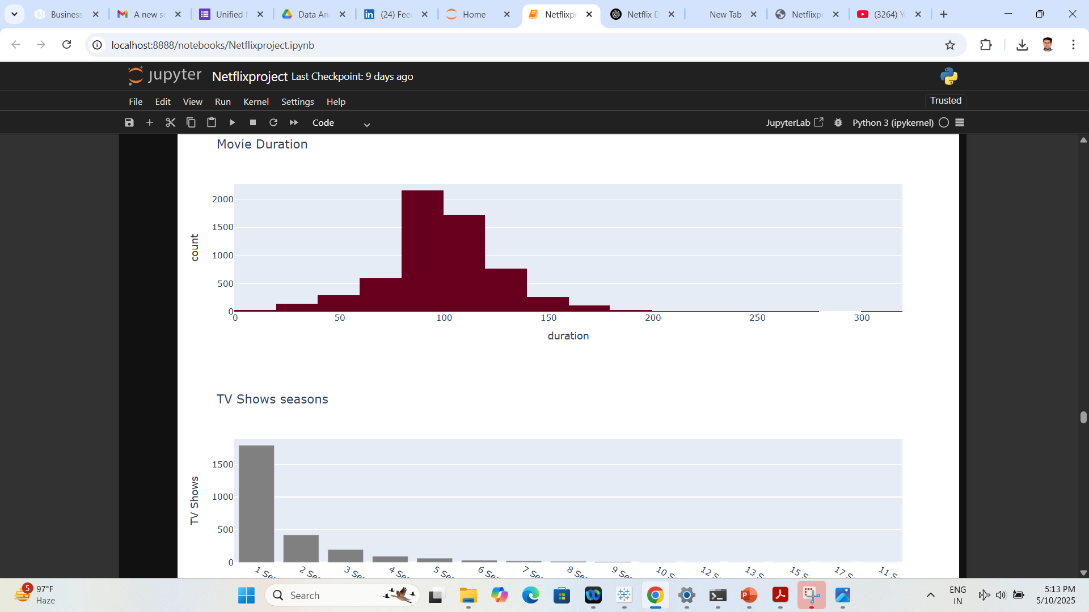
Key Insights from EDA: Movie Duration: Most Netflix movies are between 80-120 minutes, with very few exceeding 150 minutes. TV Shows: The majority of Netflix shows have only 1 season.

Slide 15
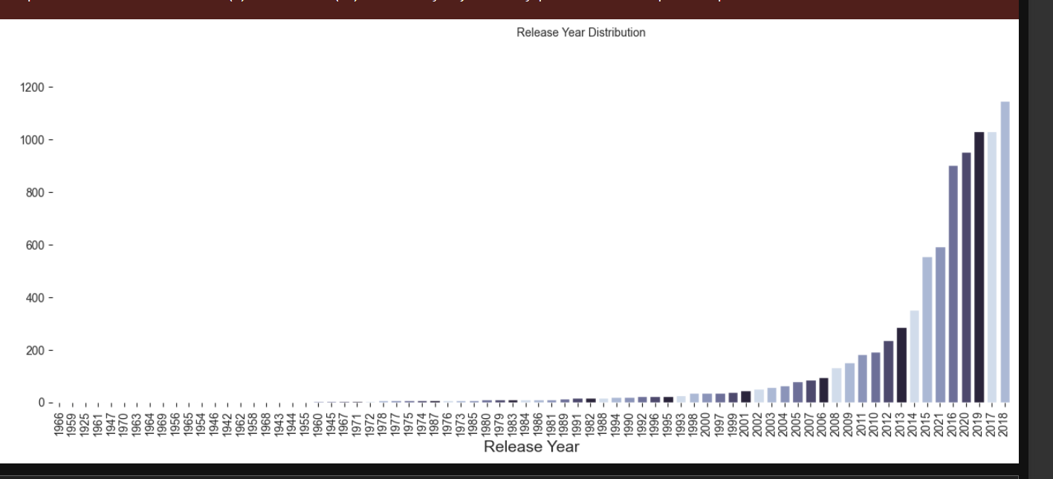
Release year distribution

Slide 16
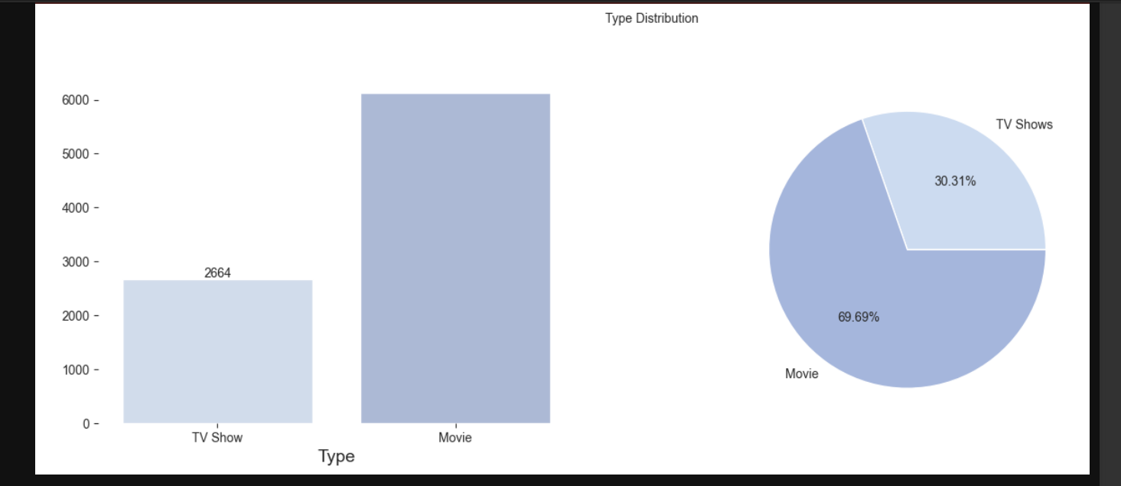
Type DISTRIBUTION

Slide 17
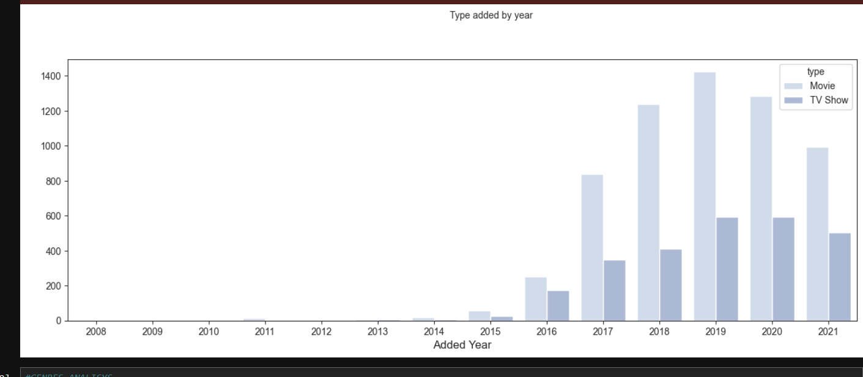
Type added by year

Slide 18
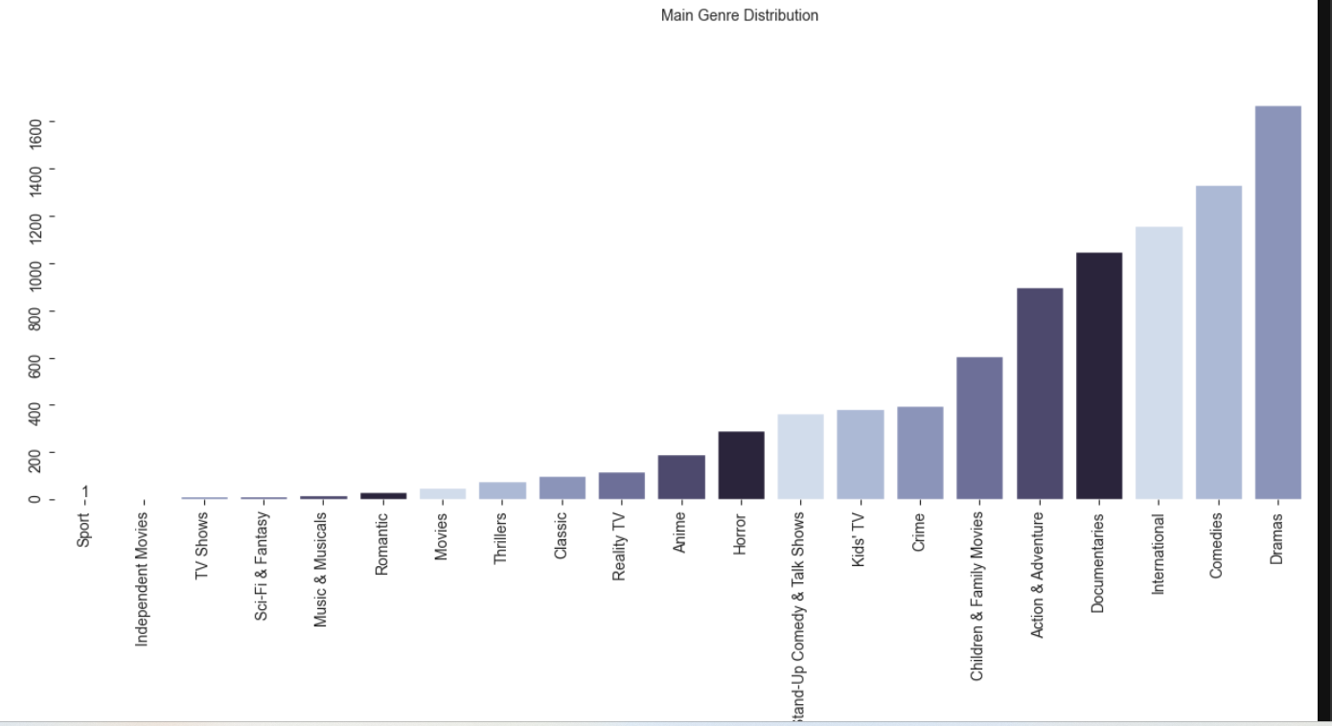
Main genre distribution

Slide 19
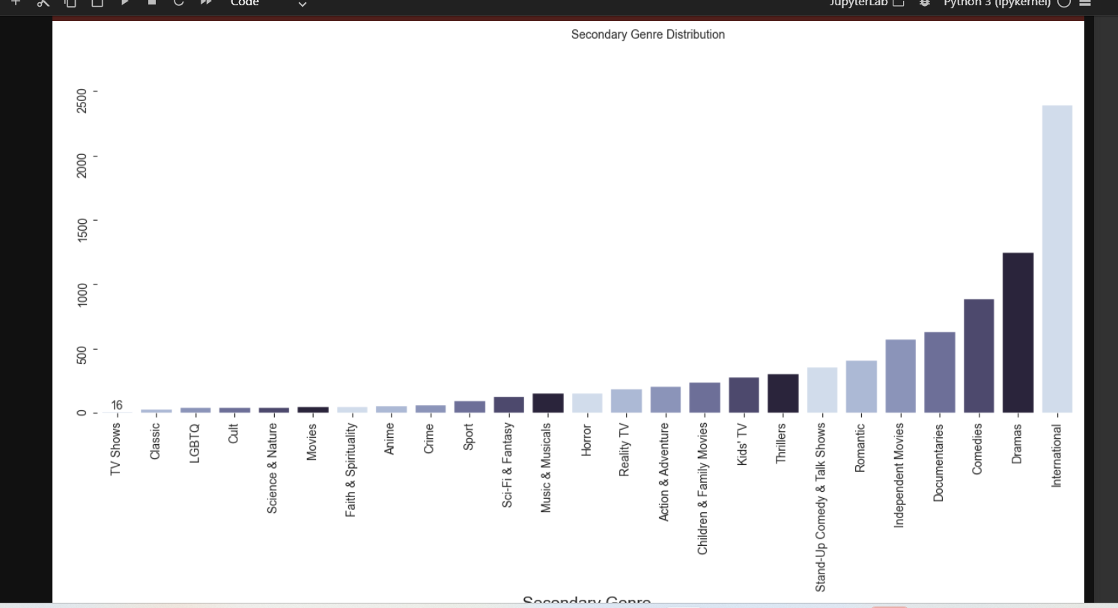
Secondary genre distribution

Slide 20
Conclusion & Future Work
Demonstrated strong skills in data cleaning, exploratory data analysis, and visual storytelling using Python.
Built a reproducible and insightful analysis workflow using industry-standard libraries (Pandas, Seaborn, Matplotlib).
Identified key trends in content type, duration, country, and ratings.
🚀 Future Work:
Engineer features to support recommendation systems.
Apply machine learning models for predictive insights (e.g., content success likelihood, genre clustering).
Deploy interactive dashboards or integrate insights into applications.

